Slide 2
Equivalence of PDAs and CFGs

Slide 3
CFGs == PDAs ==> CFLs
PDA by final state
PDA by empty stack
≡
?
CFG

Slide 4
Converting CFG to PDA
This is same as: “implementing a CFG using a PDA”
Main idea: The PDA simulates the leftmost derivation on a given w, and upon consuming it fully it either arrives at acceptance (by empty stack) or non-acceptance.
PDA (acceptance by empty stack)
accept
INPUT
w
OUTPUT
reject
implements
CFG

Slide 5
Converting a CFG into a PDA
This is same as: “implementing a CFG using a PDA”
Main idea: The PDA simulates the leftmost derivation on a given w, and upon consuming it fully it either arrives at acceptance (by empty stack) or non-acceptance.
Steps:
Push the right hand side of the production onto the stack, with leftmost symbol at the stack top
If stack top is the leftmost variable, then replace it by all its productions (each possible substitution will represent a distinct path taken by the non-deterministic PDA)
If stack top has a terminal symbol, and if it matches with the next symbol in the input string, then pop it
State is inconsequential (only one state is needed)

Slide 6
Formal construction of PDA from CFG
Note: Initial stack symbol (S) same as the start variable in the grammar
Given: G= (V,T,P,S)
Output: P_{N} = ({q}, T, V U T, δ, q, S)
δ:
For all A ∈ V , add the following transition(s) in the PDA:
δ(q, ε ,A) = { (q, α) | “A ==>α” ∈ P}
For all a ∈ T, add the following transition(s) in the PDA:
δ(q,a,a)= { (q, ε ) }
Before:
After:
A
α
…
…
Before:
After:
a…
a
a
pop
…
…

Slide 7
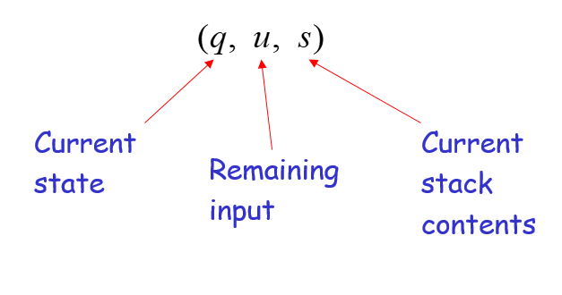
Example: CFG to PDA
1,1 / ε
0,0 / ε
ε,A / 01
ε,A / A1
ε,A / 0A1
ε,S / ε
ε,S / AS
G = ( {S,A}, {0,1}, P, S)
P:
S ==> AS | ε
A ==> 0A1 | A1 | 01
PDA = ({q}, {0,1}, {0,1,A,S}, δ, q, S)
δ:
δ(q, ε , S) = { (q, AS), (q, ε )}
δ(q, ε , A) = { (q,0A1), (q,A1), (q,01) }
δ(q, 0, 0) = { (q, ε ) }
δ(q, 1, 1) = { (q, ε ) }
ε,S / S
q
How will this new PDA work?
Lets simulate string 0011

Slide 8
Simulating string 0011 on the new PDA …
Leftmost deriv.:
1,1 / ε
0,0 / ε
ε,A / 01
ε,A / A1
ε,A / 0A1
ε,S / ε
ε,S / AS
S => AS => 0A1S
=> 0011S
=> 0011
PDA (δ):
δ(q, ε , S) = { (q, AS), (q, ε )}
δ(q, ε , A) = { (q,0A1), (q,A1), (q,01) }
δ(q, 0, 0) = { (q, ε ) }
δ(q, 1, 1) = { (q, ε ) }
ε,S / S
Stack moves (shows only the successful path):
q
0
0
A
A
1
1
A
1
1
1
1
1
Accept by empty stack
S
S
S
S
S
S
S
S
0
0
1
1
ε
S =>AS =>0A1S =>0011S => 0011

Slide 10
Example
Grammar
PDA

